Slide 1
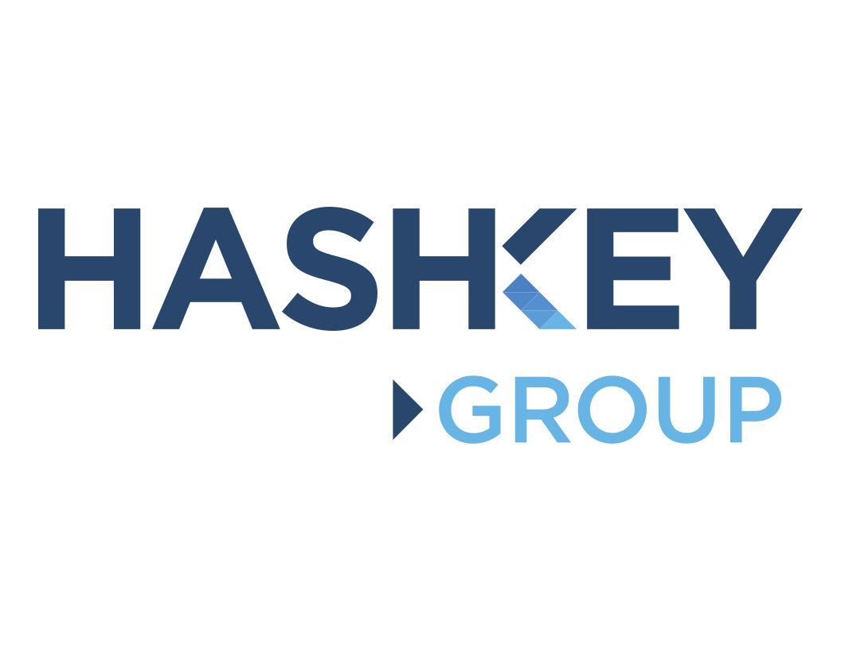
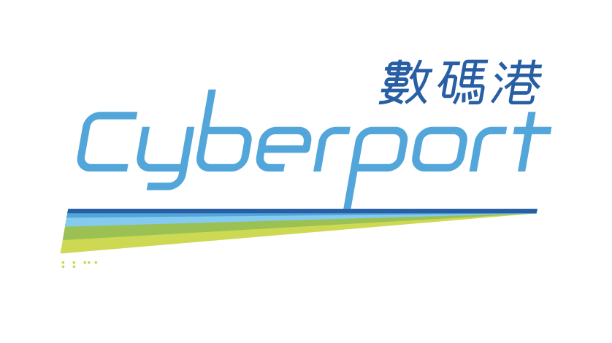
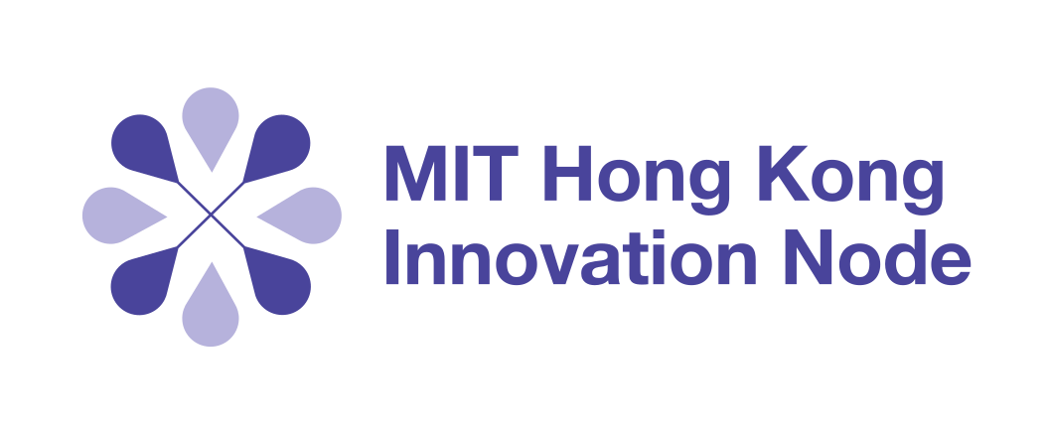
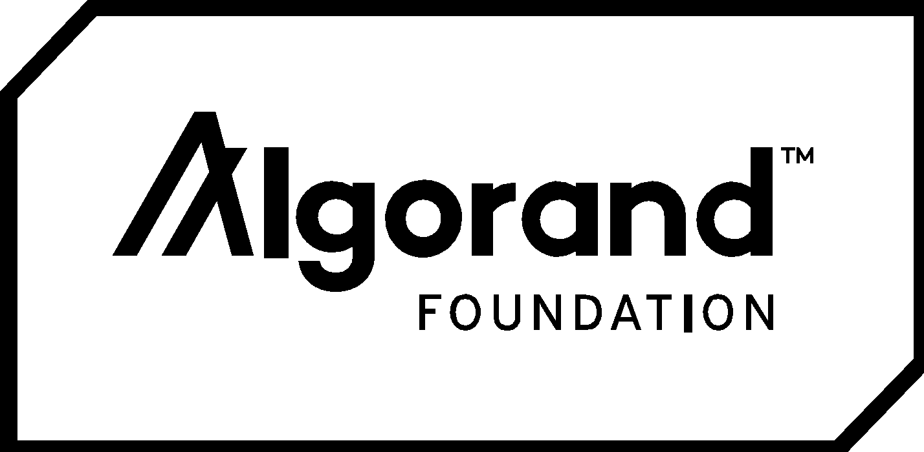
BLOCKESTATE
Team BTCHoli

Slide 2





Our Team
Rajat Jain
Varun Singh
Saksham Bhalothia
Software Engineer, 4th Year HKU
Software Engineer, 4th Year HKU
Economics & Finance, 4th Year HKU
Naman Shah
Pranav Talwar
Software Engineer, 4th Year HKU
Software Engineer, 4th Year HKU

Slide 3
Problem Statement
Inefficient Process
Capital Requirements
IP
Slow and Siloed Process
CR
Large Amounts Needed
Capital raising for public projects is extremely complex with multiple parties involved. Numerous points of truth and multiple reconciliations needed.
Public infrastructure projects often require huge amounts of capital with long gestation periods.
No Marketplace
Illiquid Investment
NM
Gap between investor and investee
II
High Denominations
The government has largely been unable to access retail investors for funding purposes as there is no marketplace for investing in such projects.
Lack of a marketplace and high denominations of bonds make these projects illiquid investments thereby decreasing their attractiveness as investment opportunities.

Slide 4


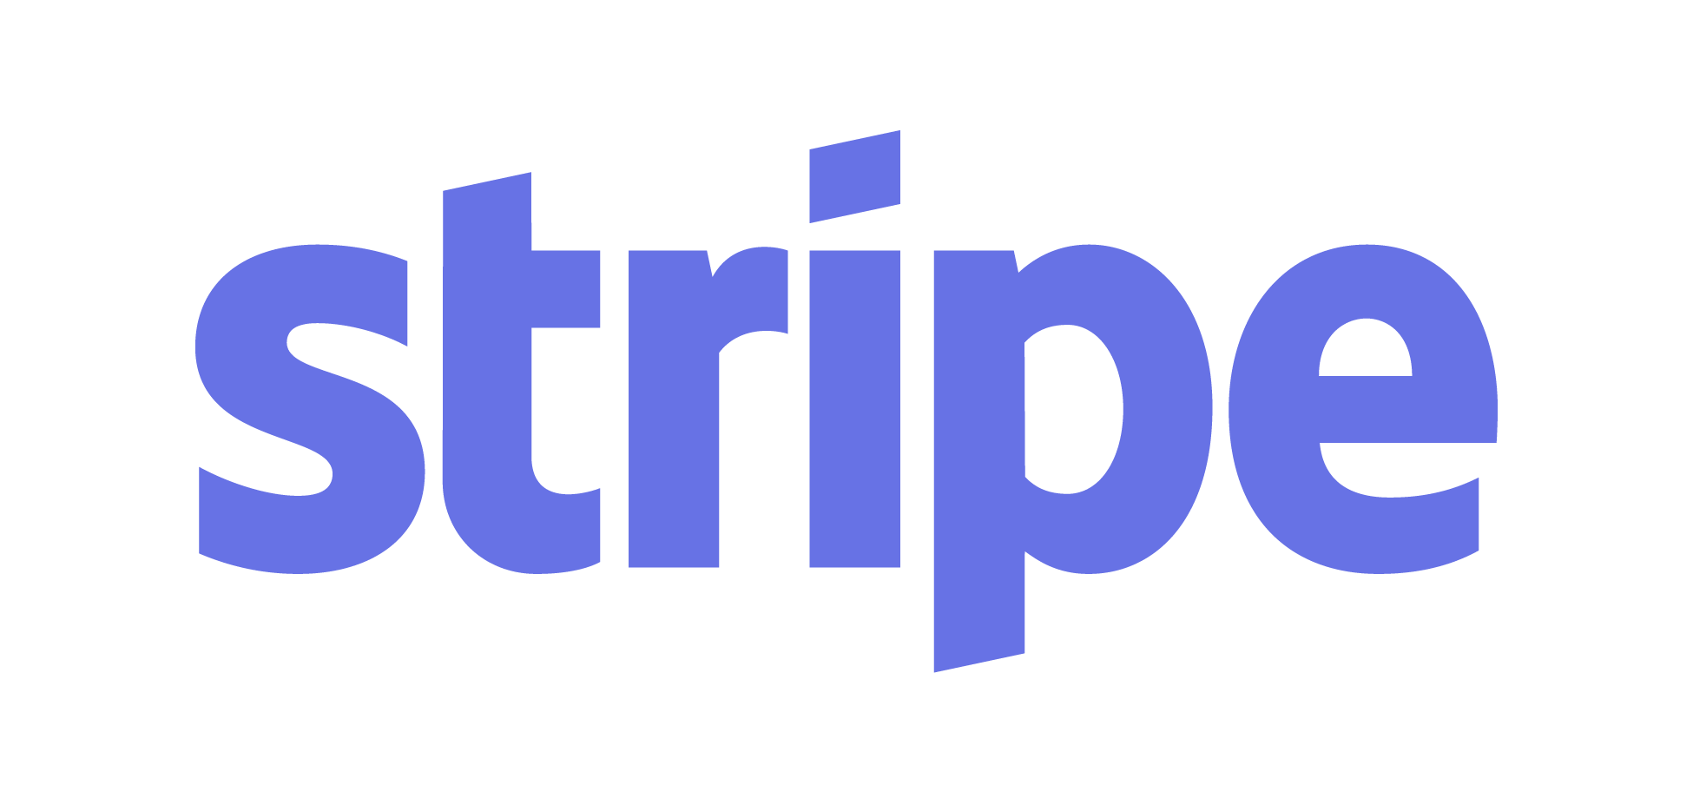
Our Solution
Issuer issues form
Lead Arranger Confirms
Asset Ledger Created and Smart Contract Deployed
Tokens received in user’s Algorand wallet
Investor views and buys from available bonds and thematic funds
Dividends received in User’s Algorand wallet
Portfolio Management via the Dashboard feature
P2P Marketplace for trading bonds

Slide 5

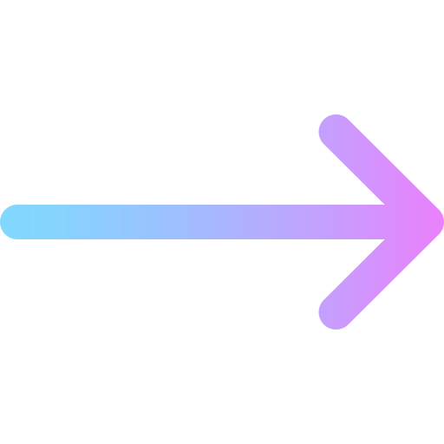
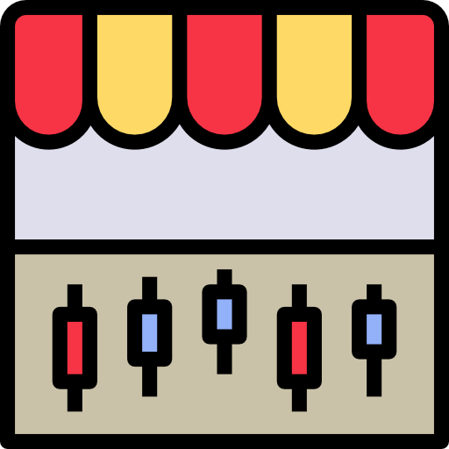





Our Solution: Efficient Bond Issuance Process
Auditor
Issuing Agent
Government
Paying and Fiscal Agent
Lead Arranger
Legal Team

Slide 6

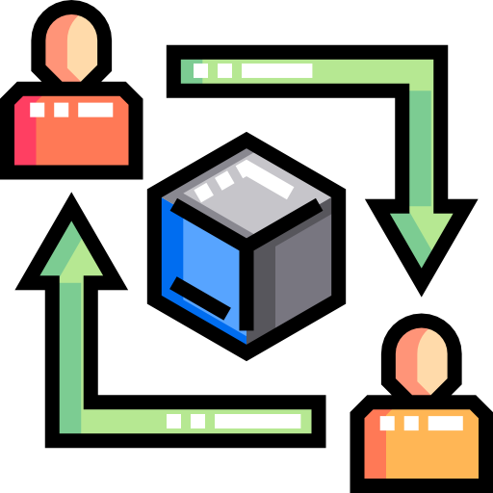

Our Solution: Marketplace for Buying and Trading Bonds
Token Subscription Portal
P2P Trading Platform
Dashboard
Tokenized assets that can be purchased via fiat currency through our portal to ensure the government’s access to a larger pool of investors.
Access to thematic funds to encourage investing into public projects
P2P platform to increase the liquidity of tokenized bonds and thereby make them attractive investments.
A dashboard to help the investor track their portfolio and better manage their investments
Referral based promotion to increase awareness and thus the investor base for public projects
Notes:
ToDo()
Empee Score ice cream cone

Slide 7

BlockEstate: Salient Features
Tokenization of the public project
Real time settlement: Bond purchases through fiat currency
Automated payment of
dividends in stable coin
Automation and better asset servicing
Investment management through portfolio dashboard
Increased liquidity through the P2P system

Slide 8
BlockEstate in Action

Slide 9



Algorand X BlockEstate
Leveraged Algorand Standard Assets(ASA) to tokenize public sector bonds
Frictionless dividend output using Algorand’s high frequency TSP
Future scalability and ability to handle multi-party transfers using Atomic Transfer

Slide 10
BlockEstate: Future Plan
Ecosystem
Eventually BlockEstate will become an end-to-end platform for public bodies to successfully raise capital for public projects through a completely digitized process.
3
KYC
The provision of due-diligence mechanism that can collect data on the investor portal and consensually share it when required.
2
Exchange
For now, our tokens will be offered on our marketplace and can be traded on the P2P portal. However, an exchange for trading of these tokens will be developed to boost liquidity.
1
Multisig
Extend the implementation of multisig authentication to add more parties that verify information before the smart contract is deployed.

Slide 11

Yours truly,
BTCholi

